Slide 1
ELM user guide
Available at
https://github.com/quantitativeimaging/ELM
Updated to 2017/09/22 version

Slide 2
Table of contents
General information
How to use this ELM software
How to read and interpret the numerical results of the ELM software :.csv, .mat & how to analyse data
Advanced settings
How to use the cylindrical shell analysis
Other notes

Slide 3
General information
Ellipsoid localisation microscopy (ELM) can be downloaded at here.
Matlab version 2016a was used for ELM development, but ELM may also work with older versions.
.tif files are preferable for input.
Some extra information are provided in Note in this guide.
This guide contains hyperlinks to help moving between pages.
Back to menu
1-1
Next section→

Slide 4
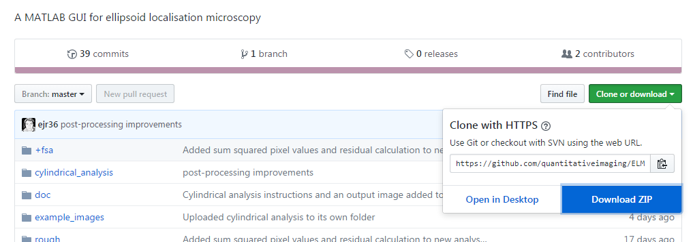
How to use this ELM software
1. Download the entire ELM folder from its Github repository and unzip it.
Click here
Then click here
←Previous section
2-1
Next section→

Slide 5
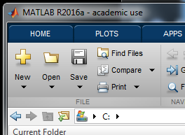
How to use this ELM software
2. Start Matlab. Set the ELM folder as the working folder.
You may place ELM-master folder in any drive. In this guide, it is located at C:\ELM-master\.
You can set ELM folder by click this button. It will open a folder browser.
←Previous section
2-2
Next section→
Notes:
It is preferable to place ELM-master in root directory of a hard drive, especially when you are operating this software in a system of other languages.

Slide 6
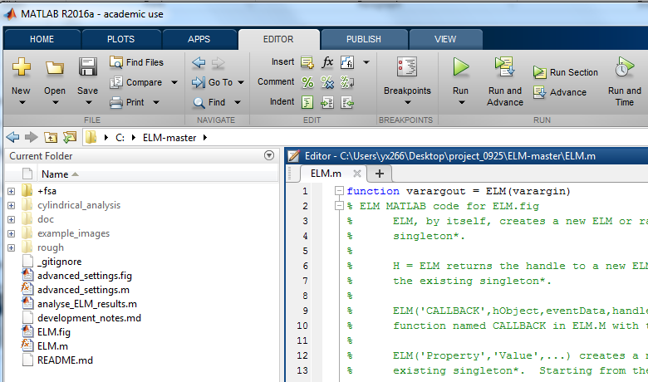
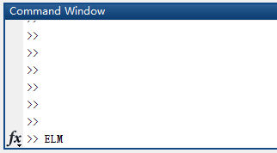
How to use this ELM software
3. Run the file ELM.m or start it from the Matlab console with the command >>ELM. This will start the graphical user interface (GUI).
You can double click the ELM.m file in Current folder then click Run.
Or key in ELM in Command Window then press Enter.
Back to page 3-7 or 5-1
←Previous section
2-3
Next section→

Slide 7
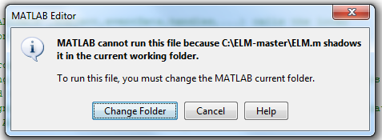
How to use this ELM software
3. Run the file ELM.m or start it from the Matlab console with the command >>ELM. This will start the graphical user interface (GUI).
If this window appears, it means the working folder is not the ELM-master folder. You can correct the setting by click Change Folder.
←Previous section
2-4
Next section→
Notes:
This usually happens when you try to run a file which is not in your working folder.

Slide 8
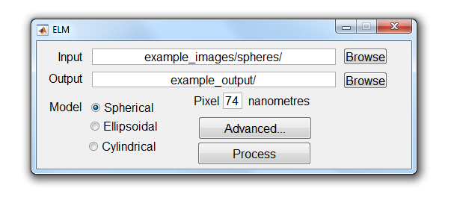
How to use this ELM software
3. Run the file ELM.m or start it from the Matlab console with the command >>ELM. This will start the graphical user interface (GUI).
This is the graphical user interface (GUI) with default parameters.
←Previous section
2-5
Next section→

Slide 9
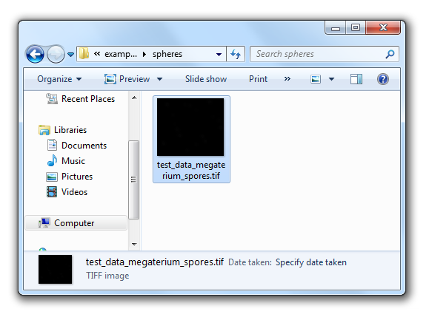
How to use this ELM software
4. Prepare a folder containing only the images to be analysed.
.TIF files are the intended format for input, but other image formats may work.
This is the example file provided in the master folder. It is possible to have multiple images in the same folder, they will be processed in sequence.
←Previous section
2-6
Next section→
Notes:
Multiple images in one folder will take more time.
It is not possible to process files in sub-folders of this folder, only files directly in this folder will be processed.

Slide 10
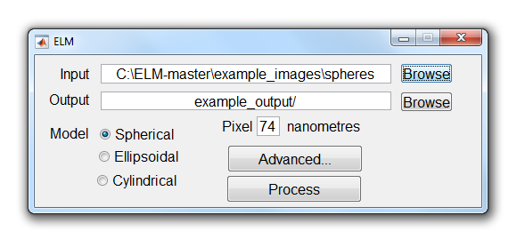
How to use this ELM software
5. In the Input field, enter the location of a folder of images that you want to process.
You can use the Browse button to select a folder, or manually key in the address.
Remember, you are selecting a folder, not a single file.
←Previous section
2-7
Next section→
Notes:
ELM has provided 2 files for your testing: Spherical and Ellipsoidal spore images.

Slide 11
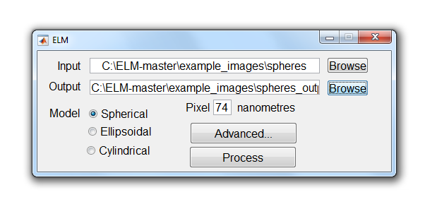
How to use this ELM software
6. In the Output field, select a folder where you want to save the results.
Similarly, you can use the Browse button to select a folder, or manually key in the address for output.
Remember, you are selecting a folder, not a single file.
←Previous section
2-8
Next section→
Notes:
Avoid choosing the input folder as the output folder. It would be very messy.

Slide 12
How to use this ELM software
7. Enter the width of the pixels on the microscopy sample and select the spore shape.
More information provided in Note of this page.
Cylindrical spore image cannot be processed by selecting model here in this version.
For Cylindrical spore image guide, click here.
For Advanced settings guide, click here.
←Previous section
2-9
Next section→
Notes:
Width of the pixels is 74 nm in the sample data, and an image containing spherical spore is used for this guide.
The ELM software should work OK if spore coats (radius ~ 500 nm) are imaged with a pixel width in about the range 50 nm to 100 nm, but this has not been explored much by the authors. Note that this length scale is not actually needed to run the ELM analysis, since parameters are saved in units of pixel widths. However this length scale needs to be known for later analysis.
The cylindrical model is implemented in the fluorescent shell analysis repository. It will be incorporated into the ELM GUI in a slightly different way, and should not be selected in the current version.

Slide 13
How to use this ELM software
8. Click the Process button. ELM will then try to process all the image data and save the results.
←Previous section
2-10
Next section→
Notes:
This should take a few seconds for the spherical model with its sample data, or a few minutes for the ellipsoidal model with its sample data.
Large folders of ellipsoidal spore images are best processed overnight.

Slide 14
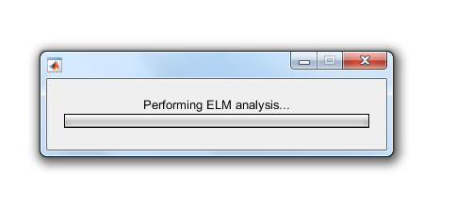
How to use this ELM software
8. Click the Process button. ELM will then try to process all the image data and save the results.
This waitbar will appear when you click Process, and will update every time the program moves on to a new file.
←Previous section
2-11
Next section→

Slide 15
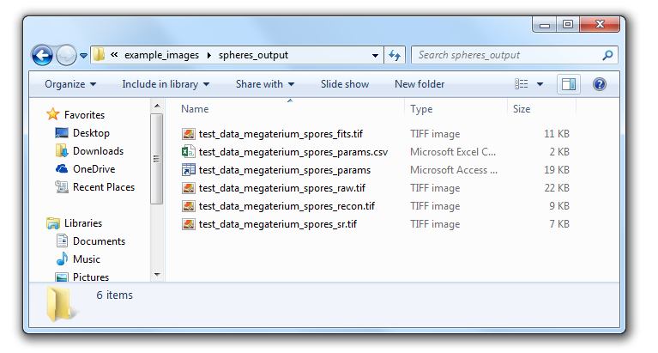
How to use this ELM software
9. For each input file, the GUI will save 4 images to the output folder, as well as an (excel-readable) .CSV file with numerical results, and a .MAT file of Matlab-readable results.
These output files will start with the same name as the corresponding input file.
Back to menu
←Previous section
2-12
Next section→
Notes:
These 4 images shows stages of process.
_raw is the raw images unprocessed.
_fits is the fitting of spore images identified.
_sr is the super-resolved spore images identified.
_recon is the reconstruction of whole image.

Slide 16
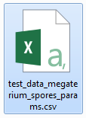
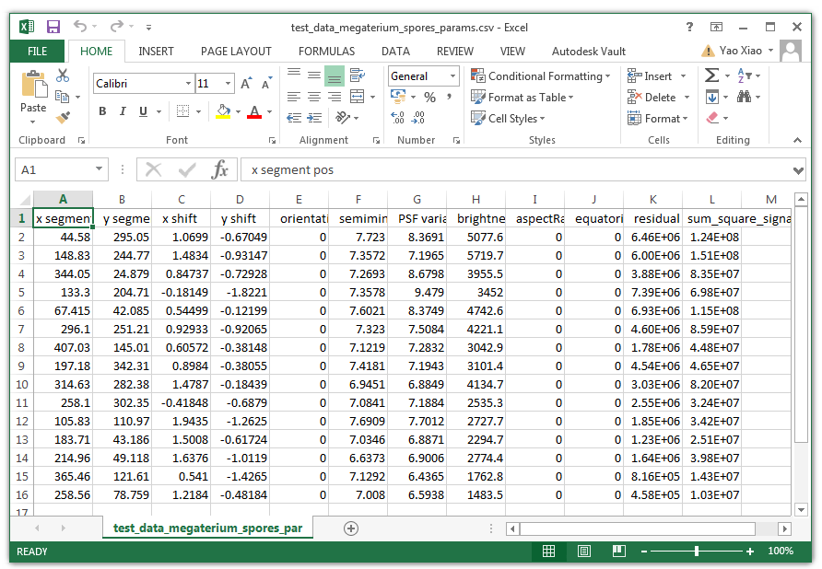
How to read and interpret the numerical results of the ELM software - .csv file
The simplest way to review the numerical results is to open the .CSV results file in Excel or some other spreadsheet. The top row of the spreadsheet gives the parameter names saved by the ELM software, and each row of numerical data underneath gives the inferred values for one candidate spore.
Detailed explained next page.
←Previous section
3-1
Next section→
Notes:
.csv is comma-separated values (CSV) files.
It is not standard .xls or .xlsx files.

Slide 17
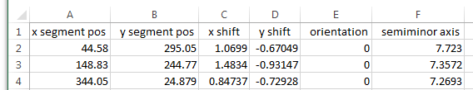
How to read and interpret the numerical results of the ELM software - .csv file
Columns 1 and 2. x segment pos (A) and y segment pos (B)are the rough XY-coordinates of the spore centre, estimated by the segmentation step of the image analysis. Units are pixel widths.
Columns 3 and 4. x shift (C) and y shift (D) are the XY-offsets to the exact centre position of the spore, obtained by the fitting step of the image analysis. Units are pixel widths.
Column 5. orientation (E) is the azimuth orientation inferred by the ellipsoidal model for a prolate ellipsoid of revolution with its long axis lying in the XY plane. This parameter is in radians, and a value of zero is recorded by default for spherical models.
Column 6. semiminor axis (F) is the radius of a spherical shell, or the semi-minor axis of an ellipsoidal shell. Units are pixel widths.
←Previous section
3-2
Next section→

Slide 18
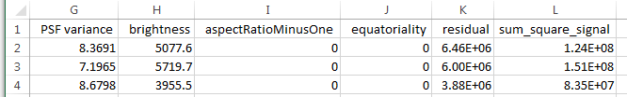
How to read and interpret the numerical results of the ELM software - .csv file
Column 7. PSF variance (G) describes the size of the point spread function (blur radius of the model microscope) fitted to the image data. Units are (pixel widths) squared. This is a useful parameter for quality control of the analysis. Fits with a PSF variance much larger than the value expected due to diffraction-limited microscope optics should be treated with caution or discarded.
Column 8. brightness (H) describes the fluorescence brightness of the spore. It is useful for comparing different spores.
Column 9. aspectRatioMinusOne (I) is needed to handle ellipsoidal spores. If the long semiaxis length is b and the short semiaxis length is a then the parameter records (b/a) - 1. A value of zero is recorded for a sphere, naturally.
←Previous section
3-3
Next section→

Slide 19
How to read and interpret the numerical results of the ELM software - .csv file
Column 10. equatorialty (J) allows for ellipsoidal spores to have non-uniform fluorescence brightness per unit of their surface area, and to be brighter at the poles (if negative) or equator (if positive). The name 'polarity' was avoided in the programming, as that name may have various biological meanings.
Column 11. residual (K) is the sum of squared differences between the fitted pixel values and the actual values in the image data. (Actual values are after uniform background subtraction, and fitted values are fitted to the background-subtracted data.) A useful way of quantifying the error of the fit is by expressing this residual as a percentage of the sum of squared signal (total fluorescence) of the sample, which is recorded in the next column. Frequently, fitting errors less that 5% or 10% seem to be of 'good quality' whereas larger values indicate that the data is not so well described by the fitted model.
Column 12. sum_square_signal (L) is the sum of squared pixel values (brightnesses) in the image data, after uniform background subtration.
Back to page 3-6
←Previous section
3-4
Next section→

Slide 20
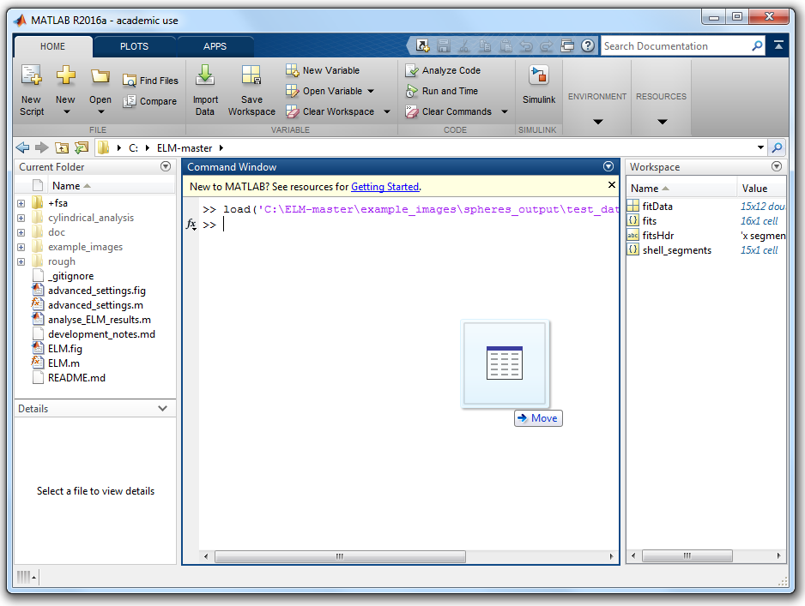
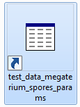
How to read and interpret the numerical results of the ELM software - .mat file
The same data recorded in the spreadsheet is also saved in a more Matlab-compatible .mat file. To read the data in Matlab, drop the .mat file onto the Matlab console.
This .ms file is considered as a access table shortcut on some PC, but it is not.
Drag and drop it into command window and data will be loaded.
←Previous section
3-5
Next section→

Slide 21
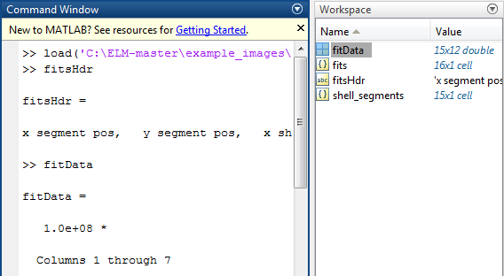
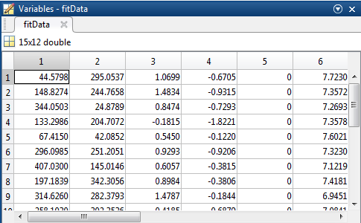
How to read and interpret the numerical results of the ELM software - .mat file
A copy of the same data is saved with the header names in the string fitsHdr and the numerical parameters for each spore stored as rows in fitData.
You can key in fitsHdr and fitData then press Enter to check values. Click here to check detailed explanation for each column.
Or double click the value column labelled.
←Previous section
3-6
Next section→

Slide 22
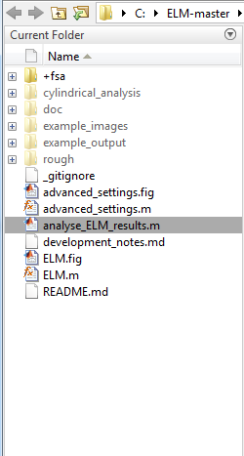
How to read and interpret the numerical results of the ELM software - .mat file
The Matlab script \analyse_ELM_results.m reads all the MAT files in an output folder and can provide a summary of the combined results of all the spores in each image.
Very similar to page 2-3, you can double click analyse_ELM_results.m file in Current Folder if you have set ELM-master as your Matlab working folder.
Or you can key in analyse_ELM_results then press enter.
←Previous section
3-7
Next section→

Slide 23
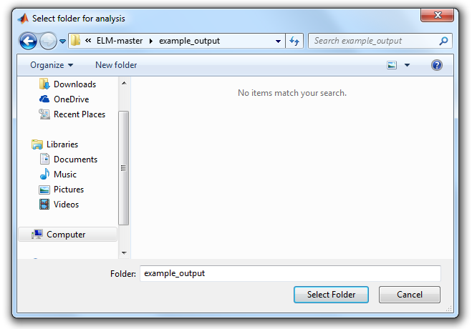
How to read and interpret the numerical results of the ELM software - .mat file
The Matlab script \analyse_ELM_results.m reads all the MAT files in an output folder and can provide a summary of the combined results of all the spores in each image.
You will be asked to select a folder for analysis. Choose a folder where .mat files are located.
Remember, you are selecting a folder, not a single file.
←Previous section
3-8
Next section→

Slide 24
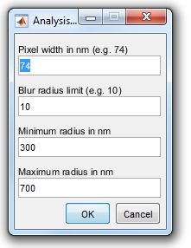
How to read and interpret the numerical results of the ELM software - .mat file
The Matlab script \analyse_ELM_results.m reads all the MAT files in an output folder and can provide a summary of the combined results of all the spores in each image.
You will be asked to provide the relevant parameters. For example image, all values are correct by default.
←Previous section
3-9
Next section→

Slide 25
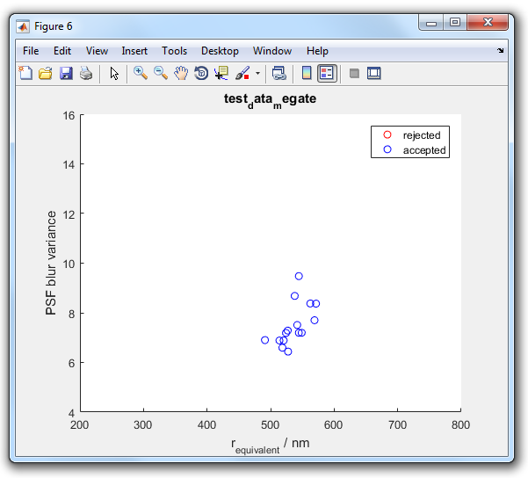
How to read and interpret the numerical results of the ELM software - .mat file
The Matlab script \analyse_ELM_results.m reads all the MAT files in an output folder and can provide a summary of the combined results of all the spores in each image.
Two figures will be produced. You can save the figures by click File – Save / Save as, or click the Save button directly.
Figures will be saved as .fig file by default, which is a matlab-readable file. You can also save in other format, such as .jpg or .png.
You can also edit the figure before saving. Check Help in Matlab for more information.
Back to menu
←Previous section
3-10
Next section→

Slide 26
Advanced settings
The Advanced button appears on the GUI opens a panel in which some image analysis settings can be adjusted.
This may be necessary for images with somewhat different scale or brightness to the sample data.
←Previous section
4-1
Next section→

Slide 27
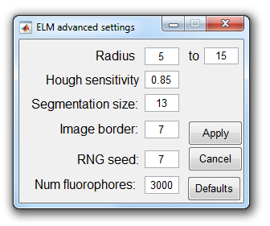
Advanced settings
Radius controls the range of circle radius, in pixel widths.
Hough sensitivity controls the sensitivity spore detecting function. Higher values will detect more candidates, but probably also more spurious candidates.
Segmentation size controls the half-width of the square segments that are selected for analysis around each candidate centre.
Bigger Image border value will result a smaller area of detection.
RNG seed sets the random number generator seed.
Num fluorophores sets the number of fluorophores simulated on each ellipsoidal spore model.
In most cases, Defaults setting is good enough to begin with. Adjusting Hough sensitivity and Image border can be the second step.
For more information, please check Note of this page.
Back to menu
Back to page 2-9
←Previous section
4-2
Next section→
Notes:
Radius controls the range of circle radius, in pixel widths, which is searched for by the imfindcircles() function in the segmentation step.
Hough sensitivity controls the sensitivity of the imfindcircles() function. Higher values will detect more candidates, but probably also more spurious candidates.
Segmentation size controls the half-width of the square segments that are selected for analysis around each candidate centre. A square of side-length 1 + 2*Segmentation size will be analysed for each candidate. For example, if the segmentation size is 13, the software will crop a region of interest of 27*27 pixels around each candidate spore location found by imfindcircles().
Image border This many pixels around the edge of the microcopy image data are excluded from analysis. If any candidate segment requires pixels from this area, it is discarded.
RNG seed This sets the random number generator seed, which means that the Monte Carlo models of ellipsoidal shells should be generated consistently in repeat analyses.
Num fluorophores Sets the number of fluorophores simulated on each ellipsoidal spore model. Smaller numbers will be faster to process, but this has not been extensively tested. The number should be big enough for the modelled images to be suitably uniform.

Slide 28
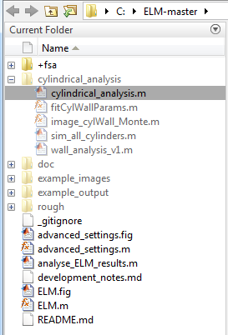
How to use the cylindrical shell analysis
1. In Matlab, open the folder \cylindrical_analysis\ and run the script cylindrical_analysis.m.
Very similar to page 2-3, you can double click cylindrical_analysis.m file in Current Folder if you have set ELM-master as your Matlab working folder.
Remember, you will need to change the working folder to
\ELM-master\cylindrical_analysis\
before you run this script.
Or you can change the working folder first then key in cylindrical_analysis then enter.
←Previous section
5-1
Next section→

Slide 29
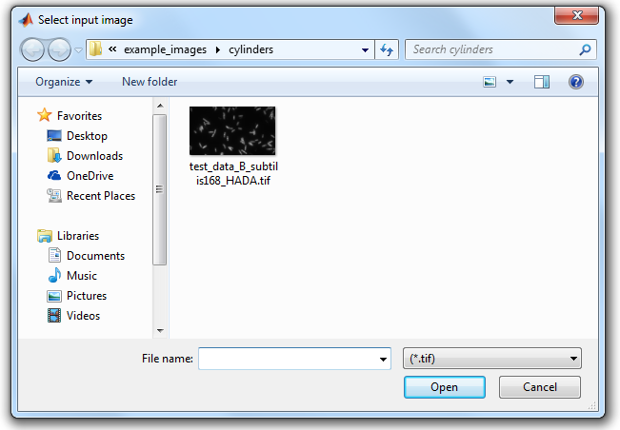
How to use the cylindrical shell analysis
2. You will be prompted to select a tif file showing some cylindrical fluorescent shells. Also you need to select a folder for output.
This is the example file provided in the master folder.
This file will be used for illustration in this guide.
←Previous section
5-2
Next section→

Slide 30
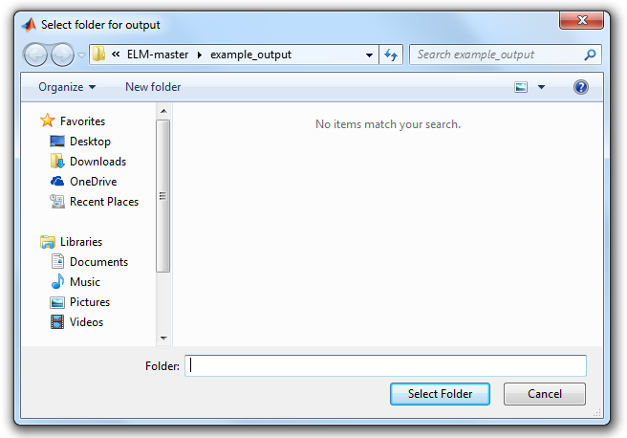
How to use the cylindrical shell analysis
2. You will be prompted to select a tif file showing some cylindrical fluorescent shells. Also you need to select a folder for output.
This is the default output folder.
You can select another one, or create a new one.
Remember, you are selecting a folder, not a single file.
←Previous section
5-3
Next section→

Slide 31
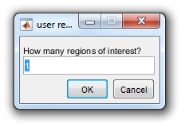
How to use the cylindrical shell analysis
3. You will be prompted to specify how many regions of interest you will manually select from the image.
Try leaving this at the default value of 1.
←Previous section
5-4
Next section→

Slide 32
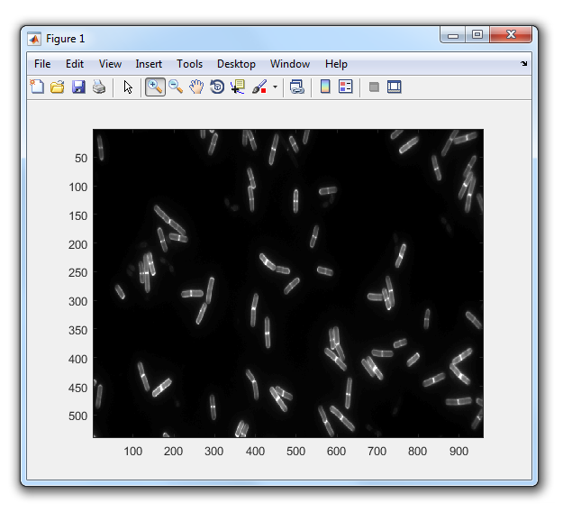
How to use the cylindrical shell analysis
4. Use the cursor on the figure showing the image file to select regions of interest.
If you set the value of 1 in last step, you will only need to select 1 section to analyse.
Zoom in can be useful in selecting the region of interest.
Selecting method on next page.
←Previous section
5-5
Next section→

Slide 33
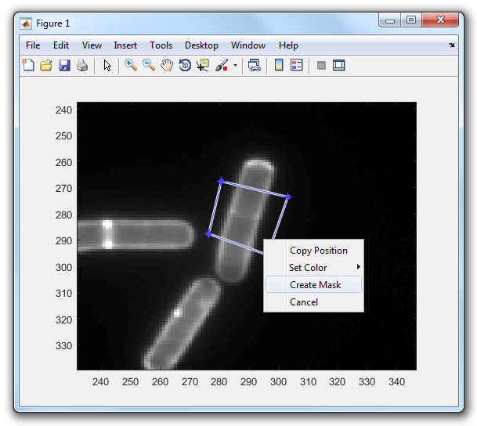
How to use the cylindrical shell analysis
4. Use the cursor on the figure showing the image file to select regions of interest.
If you zoomed in, remember to click the button again to quit Zoom in mode.
You can select the region by left-click on the first three corners of your region of interest, then double-click on the fourth to close the quadrilateral, then right-click on it and select Create Mask from the menu.
←Previous section
5-6
Next section→

Slide 34
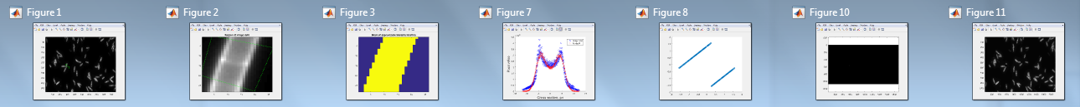
How to use the cylindrical shell analysis
5. The software will fit the cylindrical model to each specified segment.
This process will produce a series of figures, you can save the ones you are interested in.
←Previous section
5-7
Next section→

Slide 35
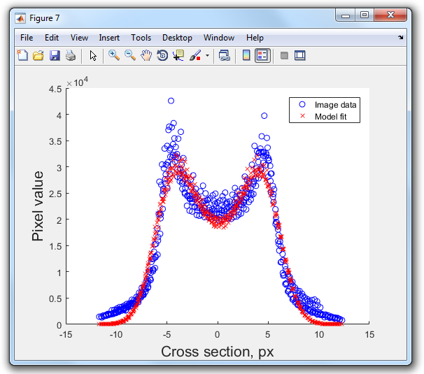
How to use the cylindrical shell analysis
5. The software will fit the cylindrical model to each specified segment.
You can save the figure by click File – Save / Save as, or click the Save button directly.
Figures will be saved as .fig file by default, which is a matlab-readable file. You can also save in other format, such as .jpg or .png.
You can also edit the figure before saving. Check Help in Matlab for more information.
←Previous section
5-8
Next section→

Slide 36
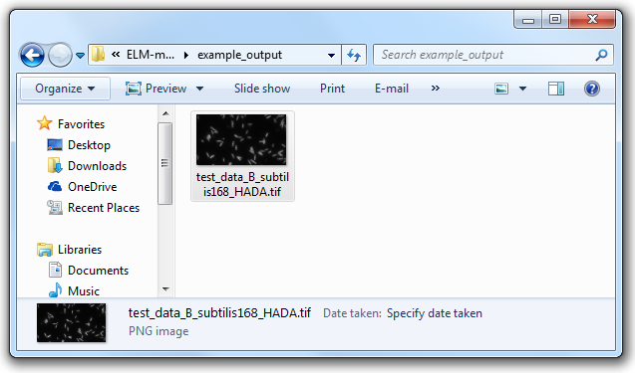
How to use the cylindrical shell analysis
6. The reconstructed images will be saved, and the fitted parameters are available in the Matlab workspace.
The reconstructed image is automatically saved in the output folder you selected in step 2.
Remember, this image is a PNG image, not a TIFF image.
←Previous section
5-9
Next section→

Slide 37
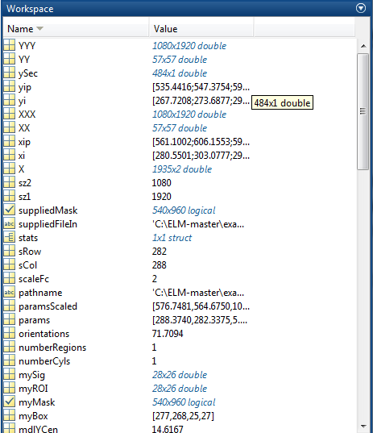
How to use the cylindrical shell analysis
6. The reconstructed images will be saved, and the fitted parameters are available in the Matlab workspace.
You can access to the parameters in workspace if interested.
You can save it by right-click in workspace an click Save.
Back to menu
←Previous section
5-10
Next section→

Slide 38
Other notes
The image segmentation step may miss a few spore images. The sensitivity parameter can be adjusted (increased) to capture more candidates, but this might introduce false positive candidates.
The image segmentation step uses imfindcircles which often returns a warning (that the function is looking for overly small circles). With the sample data, this warning is over-cautious and can be ignored.
←Previous section
6-1
Back to menu

